Slide 2
AWS GEN AI Hackathon: Aug - Oct 2024
AWS Gen AI Hackathon: member of leadership team that created and ran the Hackathon. Managed with 1 report all account and user aspects of hackathon with 800 participants, 180 accounts, and a $50k budget. The GEN AI Hackathon ran from Aug 1 through Oct 4, 2024.
I presented the overall winner submission as a featured demo in the Capgemini booth at re:Invent 2024
Details of the Hackathon
Event had almost 1700 signups, 700 active participants self organized into 180 teams
I defined and got approved the tech Budget ($40k for compute, $6500 for labor, $100 misc expenses)
I defined process to provision accounts and participants
I defined infrastructure to be able to effective secure and control usage
I defined the Organization and account structure to effectively use AWS Service credits for compute costs
I documented the process for how participants would work in Hackathon
A colleague and I provide all operational support for the teams
I defined AWS organization and User Implementation
Created user and account structure; mentored a new college grad to implement scripts
Created participant instructions and documentation
Created security controls regulating participant actions and managed exceptions
Managed help Outlook DL and monitoring of budget and system usage
Managed and worked on account and user Clean up from hackathon
I managed deprovisioning and shut down of services, accounts, and users

Slide 3
We leveraged services from onova
Link to overview of Hackathon: https://www.onova.io/capgemini-x-aws Venky Hosur (mhosur@amazon.com) can fill in any additional needed details of my involvement.

Slide 4
mgeiser.net is a domain I’ve had for a long time and I use Mgeiser@mgeiser.net as my primary personal email
I have the mail server provided via namecheap.com
In order to effectively manage the over 180 active accounts in the hackathon, I used aws_hackathon@mgeiser.net as the root for the AWS Organization and 215 email alias as the email for the root account login for the 215 member accounts provisioned.
This approached allowed me to receive all emails related to the Organization management account and all member accounts in one email inbox.
By using this design, I was able to manage requests that skirted the SCPs established. For example, the request by one team for a ml.p4d.24xlarge instance.
All internal support email from the teams went to an Outlook DL I created when went to me and a new college grad I had assisting.
I also submitted three feature requests through Venky Hosur (mhosur@amazon.com) and Niko Borodachuk (nikobrd@amazon.com)
see slide notes of last slide for content the submitted requests.

Slide 5
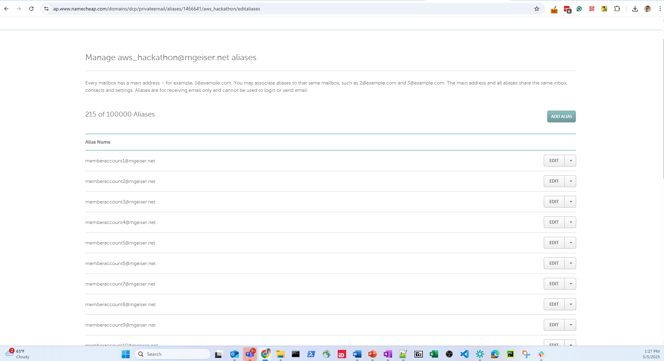

Slide 6
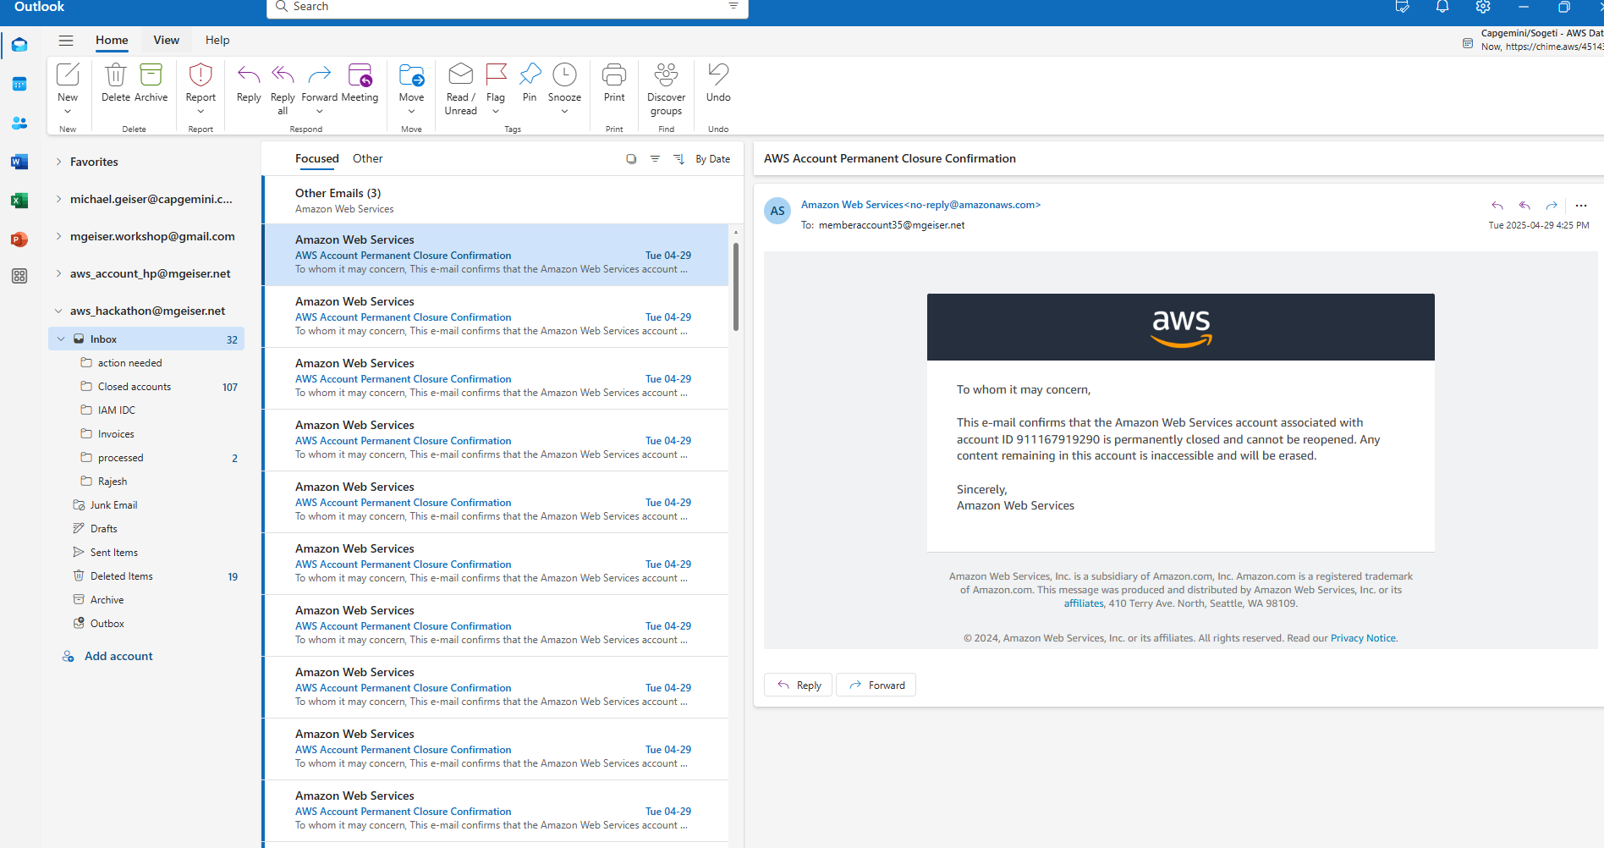

Slide 7
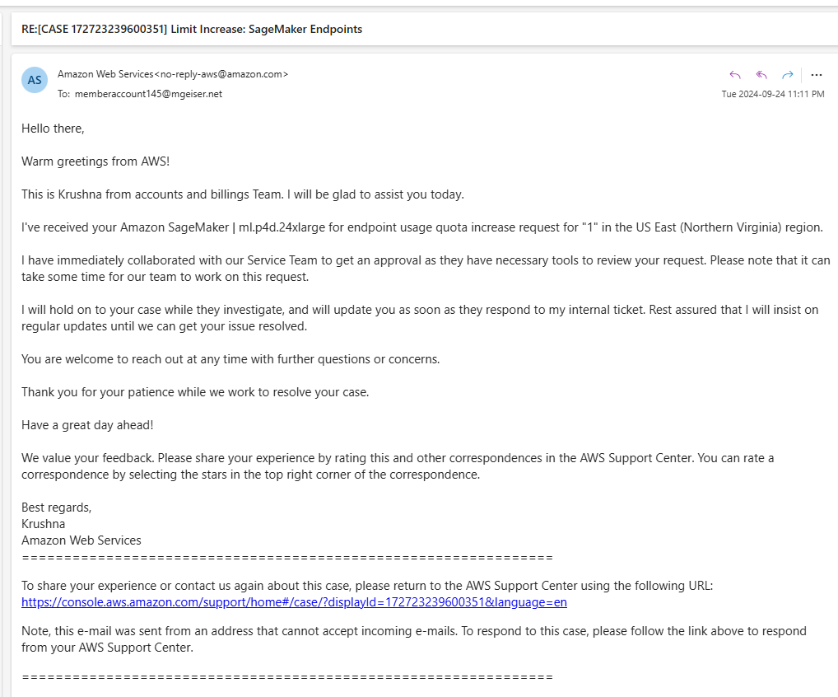

Slide 8
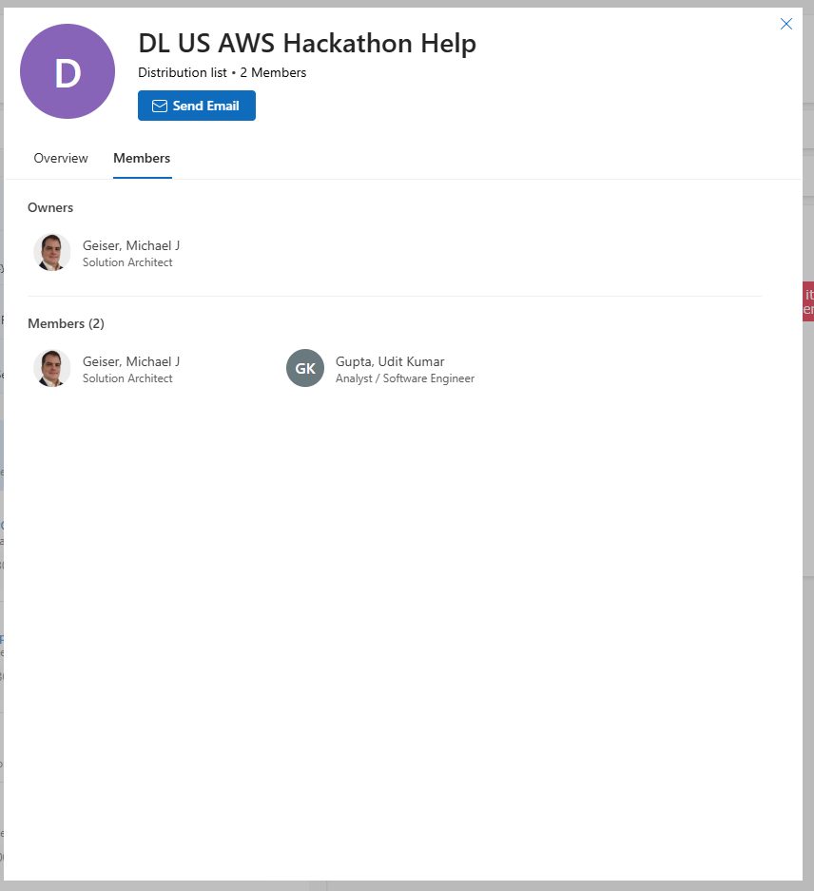

Slide 9
Submitted Feature requests
These where submitted via Capgemini’s dedicated Solution Architects
Feature Request
The Lack of an AWS Identity Center API to Disable Users is a Security Concern and inconsistent
Request to Revise AWS Organization's Account Closure Service Quota Limit
Feature Request: "Factory Reset" Functionality for AWS Accounts
The content of the requests are in the slide notes; they are too long to fit on a slide
Notes:
The Lack of an AWS Identity Center API to Disable Users is a Security Concern and inconsistent
I would like to open a request from us an AWS Premier Partner and user about this and ask that it be made a feature enhancement.
My concern is that an IDC User can be disabled in the AWS Console in the IDC Service but this feature is not available through the IDC API.
The lack of an API to disable/enable users in AWS Identity Center is not the best solution for security or efficiency. The reliance on manual intervention in the UI is inconsistent with the general AWS approach of providing programmatic control through APIs, making it difficult to automate security practices at scale.
The IDC Service in the AWS Console is capable of disabling the User so an API exists, this request asks that this important DevOps and security related API be enabled for general use.
Here are a few key reasons why the limitation is not ideal:
Automation and Security Gaps: In modern cloud environments, automation is a crucial part of managing security at scale. When user provisioning, permission assignments, or role changes are done programmatically through scripts, it allows for consistency, speed, and a reduction of manual error. However, without the ability to disable or enable a user programmatically, there's a security gap. Imagine a scenario where automated workflows detect suspicious activity or compromised credentials — the system should be able to immediately disable the user as part of an Incident Response (IR) playbook. Relying on manual intervention introduces delays and increases risk, which is particularly concerning in environments where security is "Job 0" as it is at AWS.
I should be able to disable a user but not have to change their profile as is the current suggested approach so I can re-enable them as they were when needed. This is also a security audit and compliance issue and an increased operation overhead issue
Inconsistent User Management: The fact that AWS Identity Center allows for disabling users via the UI but does not provide an equivalent API introduces an inconsistency. AWS services are often praised for their robust API support, allowing for programmatic control over almost every aspect of infrastructure and services. This inconsistency creates additional overhead for administrators who need to manage users across potentially hundreds of accounts and regions. Managing user access through the by "click-ops" though the UI is inefficient and error-prone compared to automated, verifiable, and scripted workflows.
Scalability Issues: As organizations grow and manage hundreds or thousands of users across multiple AWS accounts, relying on manual disabling/enabling through the UI becomes impractical. Organizations often have sophisticated user lifecycle management systems in place, which are integrated with identity platforms via APIs. The lack of an IDC API for user access control means either creating custom solutions or compromising on security and efficiency.
Security Audit and Compliance: From a compliance and audit perspective, the inability to programmatically disable a user means there’s no easy way to integrate this into logging systems or audit trails. This is particularly problematic in highly regulated industries where organizations must prove that user access was immediately revoked under certain conditions. Manual processes are harder to track and verify in real-time, making it difficult to maintain compliance.
Increased Operational Overhead: Not being able to integrate this functionality into existing security workflows means administrators must rely on manual processes, which increases operational overhead. This also introduces more room for human error, especially in high-pressure situations where quick action is needed to disable access.
I hope AWS considers adding this functionality to the API to ensure that organizations can seamlessly integrate user management into their security practices.
Request to Revise AWS Organization's Account Closure Service Quota Limit
I want to make a request through you to request a change to the Service Quota L-89722F41
https://us-east-1.console.aws.amazon.com/servicequotas/home/services/organizations/quotas/L-89722F41
I'd like my email associated with the request in case anyone has questions
The current Service Quota limits AWS Organizations to closing only up to 10% of member accounts within a 30-day period for organizations. This policy, while seemingly well-intentioned, presents significant operational challenges, especially in scenarios where accounts are created erroneously or by malicious actors. I attempted to outline the rationale and justification for revising the limitation and propose alternative solutions that balance security and operational flexibility.
In my specific case, I work for Capgemini, an AWS Premier Partner. We worked with AWS to host an AWS Gen AI hackathon. We created an account for each of the approximately 170 teams. With the current Service Quotas, it will take me an ENTIRE YEAR to shut down these accounts.
Current Policy and Its assumed Intent: The 10% closure limit is presumably designed to prevent accidental or malicious closure of critical accounts, protecting organizations from disruptions caused by sudden loss of access to resources. This policy assumes that limiting account closures will reduce the risk of bad actors intentionally causing harm or prevent administrators from inadvertently shutting down critical services.
This policy seems to provide encumbrances to effective management of large accounts or to manage issues from mistakes or compromised accounts without providing any real benefits or security to any Organization.
Additionally, this policy may not adequately address real-world scenarios where:
Mass Account Creation by Malicious Actors: Bad actors could infiltrate an AWS Organization and create numerous accounts, leaving the organization vulnerable to abuse and unnecessary resource consumption.
Erroneous Account Creation: Internal processes may lead to large numbers of accounts being opened unintentionally, either during testing phases, through automation errors, or via miscommunication across teams.
In both cases, the organization must retain flexibility to respond quickly by decommissioning problematic accounts to prevent further issues, such as unexpected costs or security breaches.
The use case where this policy is actually desirable is unclear. Most AWS Organizations will admittedly not hit this limit but for the few that do, the limitation prevents effective management and remediation of undesirable accounts and account usage.
Contradictory Functionality
It is possible to separate an account from an AWS Organization and then close the account without being constrained by this limit. It is manually labor intensive to separate an account from the AWS Organization and then close the account. Since this pathway is open to allow additional account closure, it is inconsistent to not allow this directly from within the AWS Organization.
Complicating Factor: Currently, AWS offers no functionality to either:
Suspend/terminate All Activity within an account (effectively pausing all ongoing services without closing the account), or
Perform a "Factory Reset" of an account, which would terminate all running services and return the account to a baseline configuration without the need for complete closure.
These features would provide organizations with the ability to neutralize the risk from accounts in a non-disruptive manner, ensuring that accounts can be secured while further decisions are made.
Key Risks of the Current Limitation:
Inability to Respond to Large-Scale Attacks or Incidents: If a large number of malicious or erroneous accounts are created, an organization might be overwhelmed by resource consumption, security threats, or compliance issues. The 10% limitation would force the organization to address the issue over a prolonged period, which could leave them vulnerable to increased costs and further exploitation.
Operational Burden and Costs: Organizations with large infrastructures may be forced to continue paying for resources in accounts that are known to be unnecessary or harmful, creating an undue financial burden, especially in cases where multiple accounts need to be purged simultaneously.
Reputational and Security Risks: Allowing compromised accounts to remain active, even if temporarily, increases the potential for data breaches, service interruptions, and reputational damage. These risks far outweigh the benefit of the 10% shutdown limit.
Proposed Compensating Controls: Instead of enforcing a rigid account closure limit, AWS could implement the following compensating controls to achieve the desired protection without limiting operational flexibility:
Allow the 10% to be changed using the request process: The best and easiest solution woudl be to allow this default limit to be changed using the same process to request other limit changes
Suspend Account Activity: Provide organizations with the ability to suspend all activity within an account. This would stop any running services, prevent further charges, and secure the account without requiring immediate closure. The account can be reactivated upon review or closed later if necessary.
Factory Reset Option: Implement a "factory reset" function that allows organizations to shut down all running services and configurations in an account, effectively neutralizing any threats or ongoing issues. This could serve as an alternative to account closure, giving the organization time to investigate without needing to terminate the account immediately.
While the current policy aims to prevent malicious closure of accounts, it inadvertently introduces significant risks and operational inefficiencies. The 10% limit is restrictive and may not reflect the realities of large-scale operations in today’s cloud environments.
The preferred solution is to lift the limit or allow the limit to be altered using the current Service Quota change request process. if AWS offered alternatives like suspension of activity or factory resets, Organizations would be empowered to handle large-scale incidents and minimize security risks without relying on the blunt instrument of account closure.
I strongly urge AWS to reconsider the "no change" limit this policy or implement flexible options that allow for rapid response to threats while maintaining the security and integrity of the organization's resources.
Feature Request: "Factory Reset" Functionality for AWS Accounts
Overview: I am requesting the introduction of a "Factory Reset" feature for AWS accounts that allows customers to restore an account to a baseline state by terminating all services and resetting configurations within the account. This feature would enable organizations to neutralize risk quickly and ensure that an account can be returned to a known, clean state without needing to close one account and open a new account, preserving important account history and reducing operational disruption.
Key Points and Justification for the Request:
Current Manual Workarounds Are Ineffective and inefficient: Today, customers who wish to achieve the effect of a "Factory Reset" must manually navigate through the AWS Console, attempting to revert changes and terminate services individually. This process is:
Time-consuming and complex: Many services are interdependent, and it can take hours or even days to identify all active services, terminate them, and verify that nothing is overlooked.
Difficult to measure effectiveness of changes: The authoritative measure of if a service has been completely shut down is whether charges are still accruing in the Billing and Cost Management Console. This is the difficult to determine as there is a delay in data coming into and displayed in the Billing and Cost Management console and the resolution of the data is "Daily". There is an "Hourly" resolution option but using this limits the amount of available billing data to only 14 days which is not an acceptable option for an Enterprise.
Error-prone: Given the complexity of modern cloud environments, it is easy to miss services or configurations that should be reset. People often do not know or remember the original baseline state of the account after extensive modifications have been made, further complicating attempts to manually revert changes.
Not always effective: Without knowing the original state, organizations may struggle to restore the account to a true baseline, leaving residual configurations that could cause problems later on.
Use of Open Source Tools Like AWS Nuke: Many customers, and even AWS employees, turn to open-source tools like AWS Nuke, which is designed to clean up accounts by deleting all resources. While this tool has gained popularity, it has several limitations:
Incomplete coverage: Open-source tools may not cover all AWS services comprehensively or keep pace with new services and configurations that AWS continuously introduces.
Potential risks: Relying on community-driven tools for critical functions can introduce risk, as these tools may not have the rigorous testing, security, and support that customers expect from AWS services. A native AWS solution would provide a more reliable, consistent, and well-supported approach to account resets, improving both quality and security.
The Inefficiency of Account Closure and Creation: Many customers resort to closing accounts entirely and opening new ones to regain a clean state. This approach has several drawbacks:
Loss of account history: When an account is closed and a new one is opened, customers lose valuable history, including billing information, CloudTrail logs, and service activity data. This data can be crucial for auditing, compliance, and troubleshooting.
Operational disruption: Closing and reopening accounts often disrupts business processes, requiring time and effort to reconfigure organizational structures, permissions, and access controls. A "Factory Reset" feature would allow organizations to retain their account history while resetting the account’s operational state, avoiding these disruptions.
The Need for Safeguards
A "Factory Reset" option is not one to be taken lightly, as it has the potential to disrupt ongoing services if used inappropriately. Therefore, I suggest possible safeguards:
Confirmation and warnings: When initiating a Factory Reset, administrators should receive clear warnings about the impact, with detailed information on which services will be terminated and what data will be lost.
Multi-step approval process: For additional security, the reset process could require approval from multiple account administrators, especially in larger organizations, to ensure it is a deliberate non-malicious action.
Waiting period before taking effect: A waiting period, like that implemented in the Key Management Service when deleting a Key would be a prudent requirement.
Logging and auditing: All reset actions should be logged in AWS CloudTrail, allowing organizations to audit when and why the reset occurred, and by whom.
A "Factory Reset" feature would provide customers with a powerful tool to revert AWS accounts to a baseline state quickly and efficiently. It would address the challenges and inefficiencies of current manual workarounds, reduce reliance on third-party tools, and prevent the loss of valuable account history caused by account closure and re-creation. With appropriate safeguards in place, this feature would offer customers greater control and security while improving operational flexibility.
I strongly suggest AWS consider implementing this feature to better meet customer needs in managing and maintaining their accounts.

